Slide 1
Capability Maturity Model (CMM)
For Software

Slide 2
CMM for Software
The Capability Maturity Model for Software (SW-CMM) - a model for
  judging the maturity of the software processes of an organization
  identifying the key practices that are required to increase the maturity of these processes
  assessing and improving software processes

Slide 3
Let us understand –
A Process
A Software Process
Software Process Capability
Software Process Performance
Software Process Maturity and
Maturity Level

Slide 4
Process & Software Process - Defined
A process is -
  "a system of operations in producing something ... a series of actions, changes, or functions that achieve an end or result”
  "a sequence of steps performed for a given purpose" [IEEE-STD-610]
A software process is -
  a set of activities, methods, practices, and transformations that people use to develop and maintain software and the associated products (e.g., project plans, design documents, code, test cases, and user manuals)

Slide 5
Software Process Capability - Defined
Software process capability
  describes the range of expected results that can be achieved by following a software process
  provides one means of predicting the most likely outcomes to be expected from the next software project the organization undertakes

Slide 6
Software Process Performance - Defined
Software process performance
  represents the actual results achieved by following a software process
  focuses on the results achieved, while software process capability focuses on results expected
  Based on the attributes of a specific project and the context within which it is conducted, the actual performance of the project may not reflect the full process capability of the organization; i.e., the capability of the project is constrained by its environment

Slide 7
Software Process Maturity - Defined
Software process maturity is the extent to which a specific process is explicitly defined, managed, measured, controlled and effective
Maturity implies a potential for growth in capability and indicates both the richness of an organization's software process and the consistency with which it is applied in projects throughout the organization

Slide 8
Maturity Level - Defined
A maturity level -
  is a well-defined evolutionary plateau towards achieving a mature software process
  provides a layer in the foundation for continuous process improvement
  comprises a set of process goals that, when satisfied, stabilize an important component of the software process
  When achieved establishes a different component in the software process, resulting in an increase in the process capability of the organization

Slide 9
Organizing CMM into Five Maturity Levels
Initial
  Software process characterized as ad hoc and occasionally even chaotic
  Few processes defined and success depends on individual effort and heroics
Repeatable
  Basic project management processes established to track cost, schedule, and functionality
  The necessary process discipline in place to repeat earlier successes on projects with similar applications

Slide 10
Five Maturity Levels
Defined
  The software process for both management and engineering activities documented, standardized, and integrated into a standard software process for the organization
  All projects use an approved, tailored version of the organization's standard software process for developing and maintaining software

Slide 11
Five Maturity Levels
Managed
  Detailed measures of the software process and product quality collected
  Both the software process and products are quantitatively understood and controlled
Optimizing
  Continuous process improvement enabled by quantitative feedback from the process and from piloting innovative ideas and technologies

Slide 12
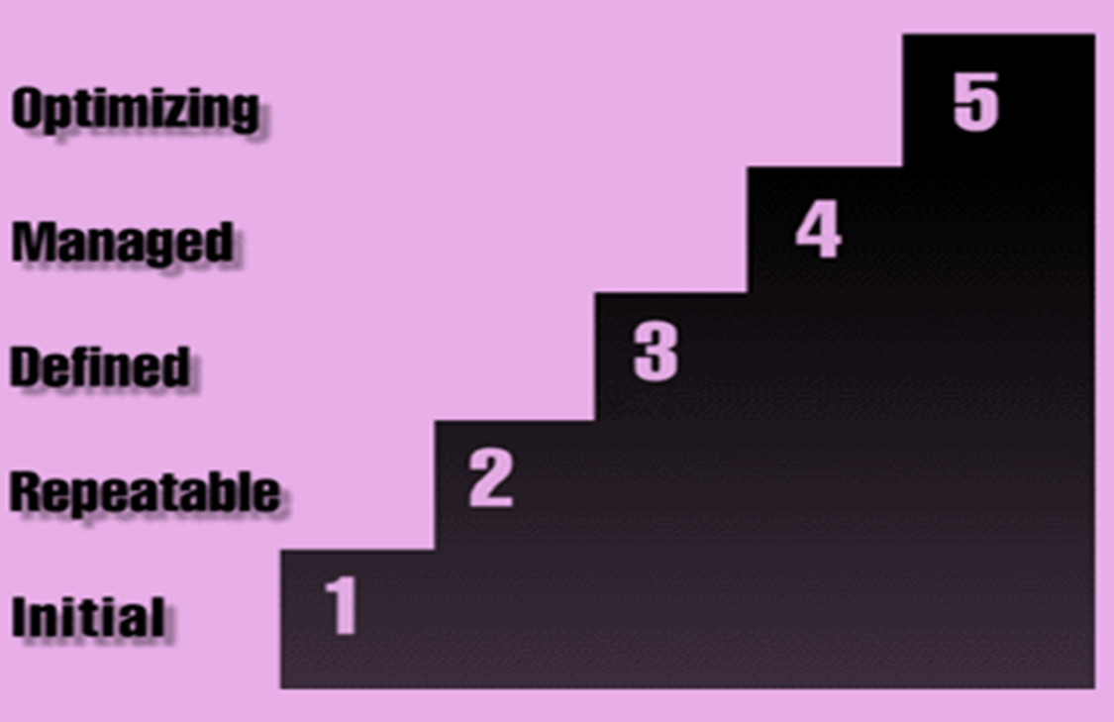
SW-CMM Levels

Slide 13
Using the CMM
CMM
  has specific value in the areas of action planning, implementing action plans, and defining processes

Slide 14
What CMM does not cover
Describes an organization at each maturity level without prescribing the specific means for getting there
Does not tell an organization how to improve
Does not currently address expertise in particular application domains, advocate specific software technologies, or suggest how to select, hire, motivate, and retain competent people

Slide 15
Summary
indicate
Maturity Levels
Process Capability
contain
Key Process Areas
achieve
Goals
Organized by
Common Features
address
Institutionalization
contain
Key Practices
describe
Activities

